Slide 1




CORONA VIRUS
ANALAYSIS
SQL Analysis
Joel George

Slide 2

Contents
01
Introduction
02
Problem Statement
03
Dataset Overview and Explanation
04
Analysis using SQL

Slide 3


Introduction
Corona virus disease 2019 (COVID-19) is a contagious disease caused by the coronavirus SARS-CoV-2. The first known case was identified in Wuhan, China on December 2019. The disease quickly started spreading worldwide, resulting in the COVID-19 pandemic.

Slide 4


Problem Statement
Overview
The COVID-19 pandemic has significantly impacted global health and economies. Understanding the spread and impact of the virus through data analysis is crucial.
Purpose
To derive meaningful insights from COVID-19 data to better understand the spread, mortality, and recovery rates This analysis uses SQL to showcase the key insights of its spread globally in year 2020 &2021

Slide 5
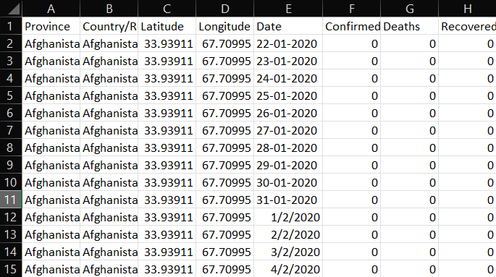
Dataset Overview &
Explanation
Province: Geographic subdivision within a country/region.
Country/Region: Geographic entity where data is recorded.
Latitude: North-south position on Earth's surface.
Longitude: East-west position on Earth's surface.
Date: Recorded date of COVID-19 data.
Confirmed: Number of diagnosed COVID-19 cases.
Deaths: Number of COVID-19 related deaths.
Recovered: Number of recovered COVID-19 cases.

Slide 6

ANALYSIS
USING
SQL

Slide 7


CODE TO CHECK NULL VALUES

Slide 8
UPDATING THE NULL VALUE WITH 0

Slide 9
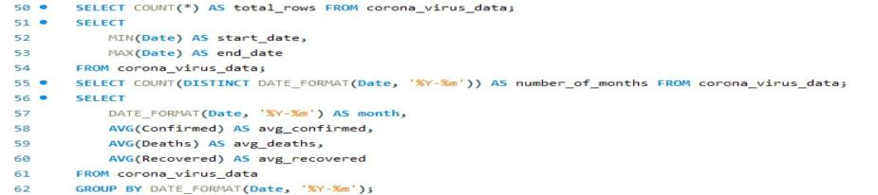

TOTAL NUMBER OF ROWS
TOTAL 78386

Slide 10

START DATE & END DATE
Start Date: 22/01/2020
End Date: 13/06/2021

Slide 11

NUMBER OF MONTHS IN THE DATASET
TOTAL : Months 18

Slide 12
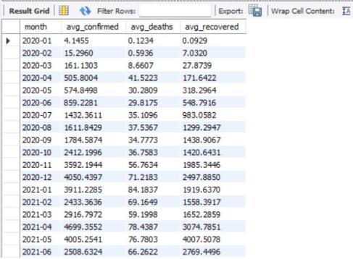
MONTHLY AVERAGE FOR CONFIRMED, DEATHS & RECOVERED

Slide 13

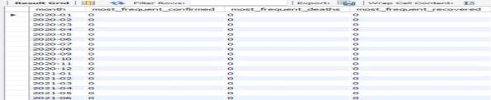
MOST FREQUENT VALUES FOR CONFIRMED, DEATH AND RECOVERED CASES

Slide 14

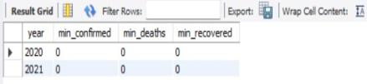

MINIMUM / MAXIMUM ?
VALUES PER YEAR

Slide 15
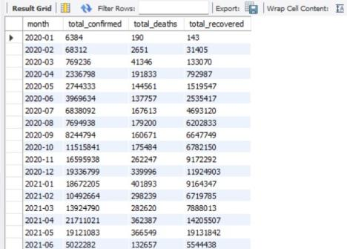

TOTAL NUMBER OF CASES IN EACH MONTH

Slide 16
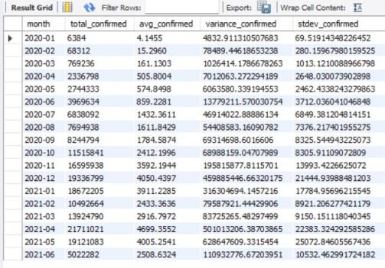
VIRUS SPREAD WITH RESPECT TO CONFIRMED CASES

Slide 17
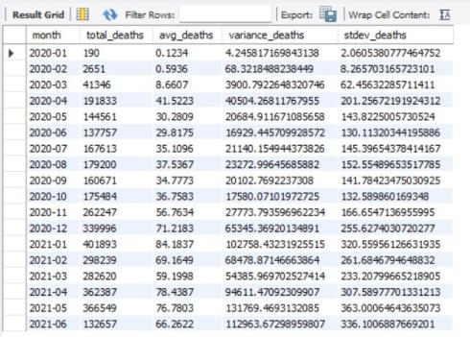

VIRUS SPREAD WITH RESPECT TO DEATH CASES

Slide 18
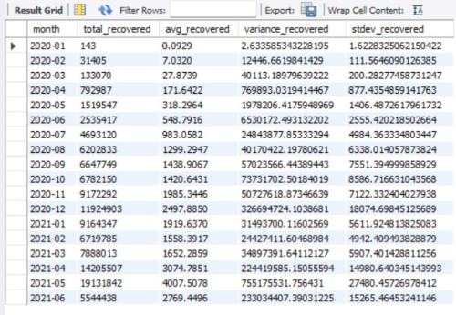
VIRUS SPREAD WITH RESPECT TO RECOVERED CASES

Slide 19
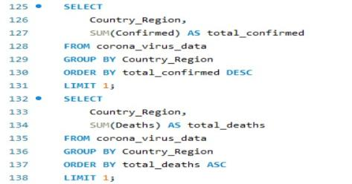

COUNTRY HAVING HIGHEST NUMBER OF CONFIRMED CASES

Slide 20

COUNTRY HAVING LOWEST NUMBER OF DEATH CASES

Slide 21
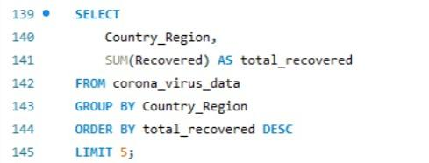
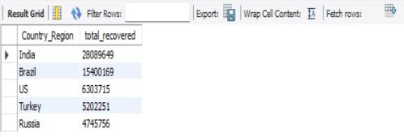
TOP 5 COUNTRIES HAVING HIGHEST RECOVERED CASES
INDIA
BRAZIL
US
TURKEY
RUSSIA

Slide 22
KEY INSIGHTS
Confirmed Cases by Country:
Highest in countries with large populations and high international travel (e.g., USA, India, Brazil).
Mortality Rates:
Highest deaths in countries with strained healthcare systems (e.g., USA, Brazil, India, Mexico).
Recovery Rates:
High recoveries in countries with effective healthcare responses (e.g., China, USA, Brazil, India).
Temporal Trends:
Peaks and troughs in data correlate with pandemic waves and public health measures.
Geographic Distribution:
Significant outbreaks in North America, Europe, and Asia; urban centers and high population densities more affected.
Impact of Public Health Policies:
Early measures (e.g., travel restrictions, testing) effectively controlled the spread.
Healthcare System Preparedness:
Countries with robust healthcare systems had better outcomes.

Slide 23
CONCLUSION
The SQL analysis of the COVID-19 dataset provides valuable insights into the pandemic's dynamics, highlighting the importance of healthcare infrastructure, early intervention, and global cooperation. These findings can inform future public health strategies and policies to better prepare for and manage pandemics, ultimately saving lives and mitigating economic and social impacts.
Conclusion 03

Slide 24
THANK YOU

